Slide 1
Manufacturing Task Tracker (MTT) 2017 Updates - Phase 2 May, 2017

Slide 2
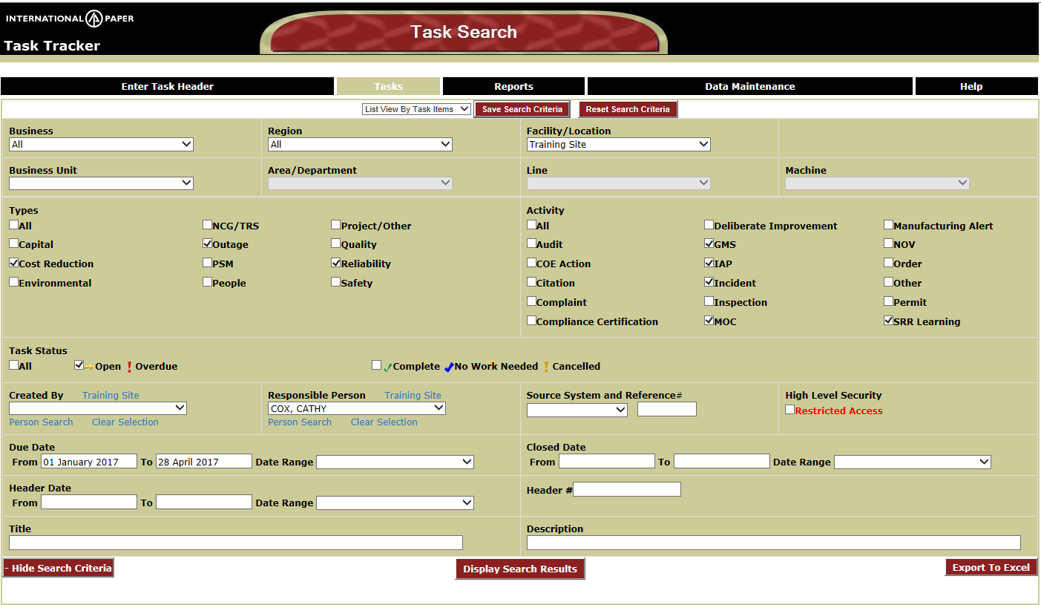

Task Search Page – Save Search Defaults
New buttons at top of page (see next to red arrow)
Select which view you would like to be your default (Calendar, Headers, Task Items)
Select values for dropdowns , checklists, dates, date ranges, text fields (any or all fields can be saved)
Click the Save Search Criteria button to Save your search criteria for subsequent browser sessions
One set of variables can be saved per user
Defaults will be used for Enter Task Header/Tasks/Reports pages
Click Reset Search Criteria to refresh the values on the search page to your saved defaults
Notes:
An image of the MTT screen would be here. Also, if you are going to have a website with information about the MTT (faqs), this would be a good page to link to it.

Slide 3
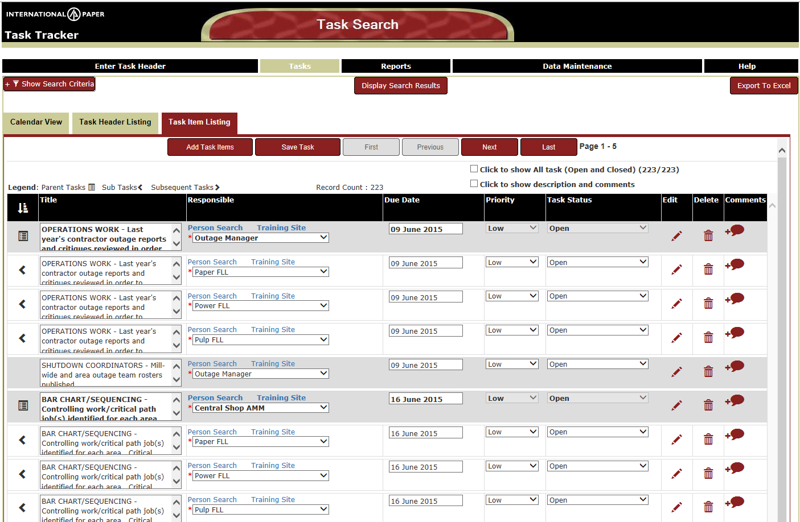
Task Item Listing – New Layout
Added Description and Comments fields - use Toggle switch to Hide/Show fields
Subsequent and Sub Tasks sorted with Parent
Parent Tasks– Shaded Gray with icon (see Legend above grid)
Subsequent tasks – White with icon
Subtasks – White with icon
Added Icons (right side of grid) for editing, deleting, adding comments for each task
Notes:
An image of the MTT screen would be here. Also, if you are going to have a website with information about the MTT (faqs), this would be a good page to link to it.

Slide 4
Task Item Listing – Sorting
Parents/Subtasks may not be in list depending on selection criteria
Dates may be out of sequence when honoring parent/subtask relationships
Sorting by column header titles still available
Icon in header of first column will allow the parent/subtask groupings to be resorted (circled)
Notes:
An image of the MTT screen would be here. Also, if you are going to have a website with information about the MTT (faqs), this would be a good page to link to it.

Slide 5
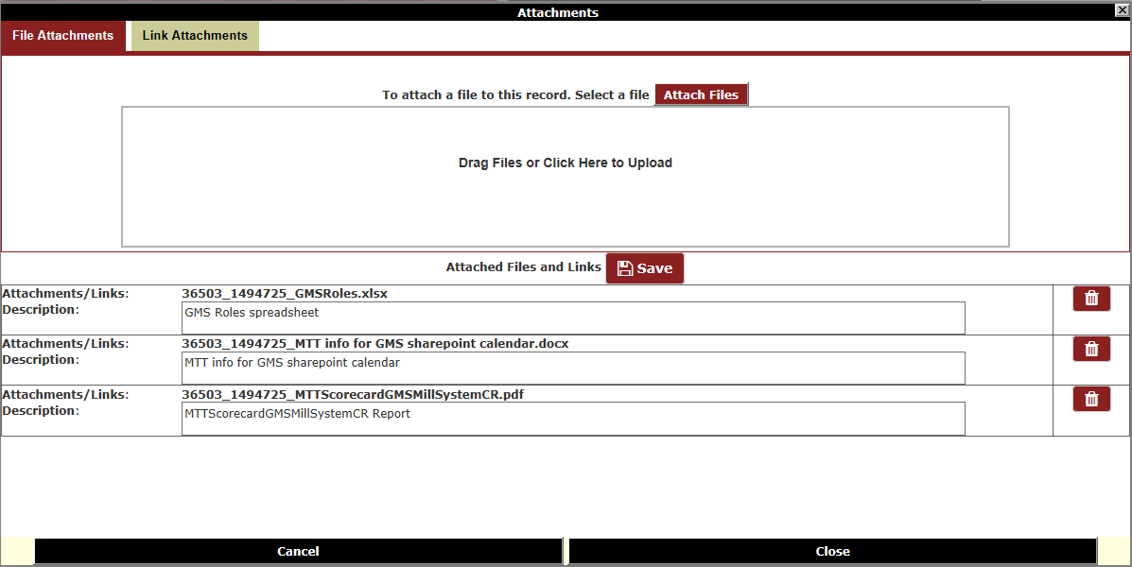
Attachments – Drag and Drop
Drag and Drop feature added to the File Attachments page
Clicking in box labeled “Drag Files or Click Here to Upload” will display/open Windows Explorer
From Windows Explorer locate file to attach – drag to the box labeled “Drag Files or Click Here to Upload”
Click Attach Files button to attach to the task
Descriptions can be updated in the grid below – Click Save button when editing is complete
Click on Trash Can icon to delete an attachment from the task
Notes:
An image of the MTT screen would be here. Also, if you are going to have a website with information about the MTT (faqs), this would be a good page to link to it.

Slide 6
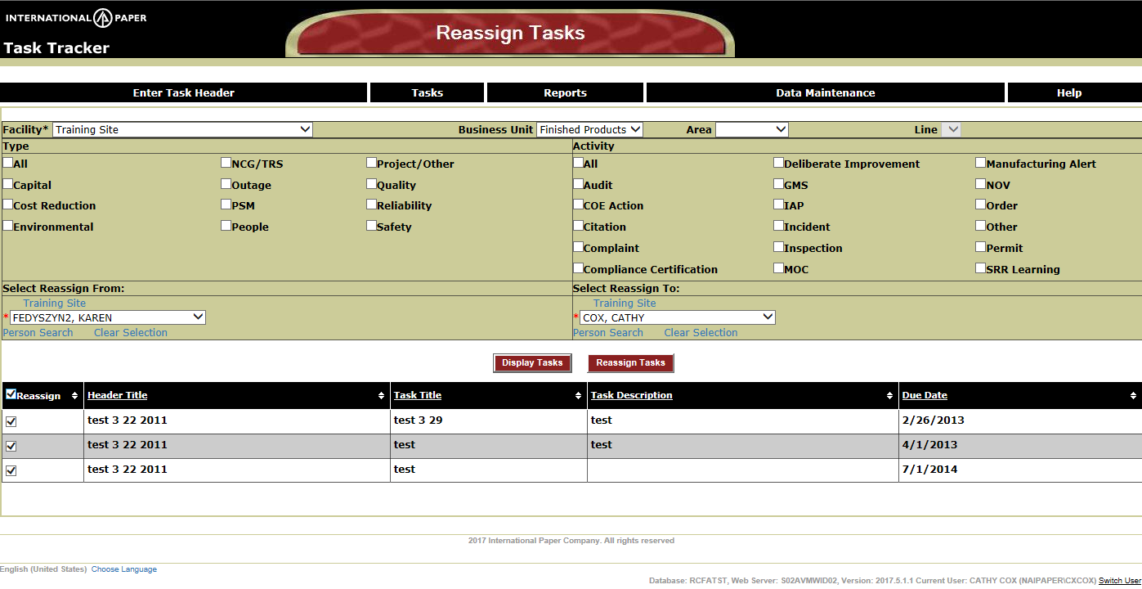
Data Maintenance – Reassign Tasks
New Reassign Tasks page on the Data Maintenance menu – Facility Admin access required
Select Facility (required) – any other filters are optional
Select Reassign From (required) – List of active and inactive users
Click Display Tasks to view all open tasks for the responsible person (filters applied to task results)
All tasks will be checked to be reassigned as default – Tasks can be unchecked if necessary
Select Reassign To (required) – One active user or role can be selected
Click Reassign Tasks button
All checked tasks will be reassigned to the new assignee
Notes:
An image of the MTT screen would be here. Also, if you are going to have a website with information about the MTT (faqs), this would be a good page to link to it.

Slide 7
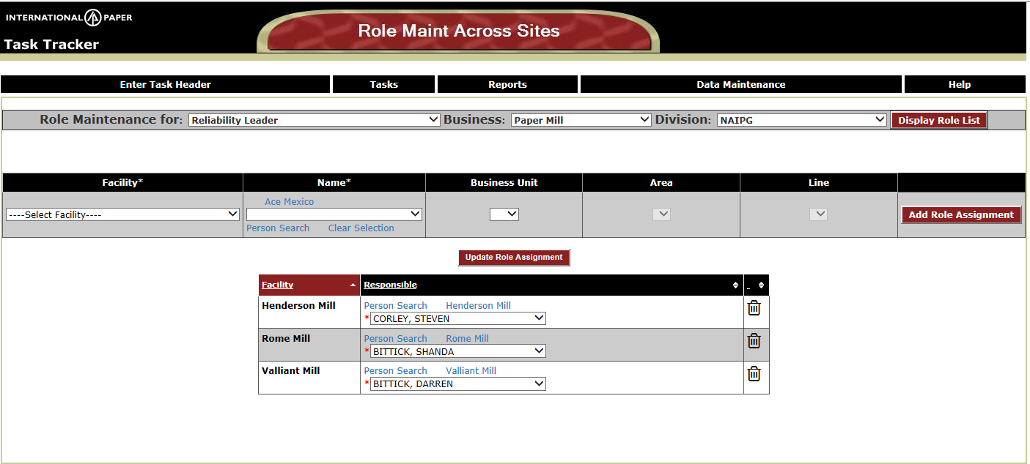
Data Maintenance – Role Maint Across Sites
New Role Maint Across Sites page allows assignment for one role across all sites
Special support access (Enterprise Administrator role); SDM ticket required to set up access
Role Maintenance for: Select a role to assign across the Enterprise (required field) – business/division optional filters
Click Display Role List button
List of facilities with person assigned to the role selected will be displayed
Select a person from the Responsible dropdown – Click Update Role Assignment button to Save changes
Click on Trash Can icon to delete a role assignment
Add new assignments by selecting the Facility/Name/BusUnit/Area/Line – Click Add Role Assignment button

Slide 8
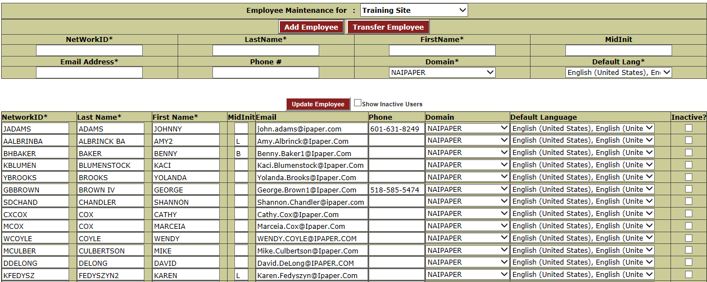
Data Maintenance – Employee Maintenance
Show Inactive Users toggle switch allows inactive users at the site to be displayed
Employee changes will take affect immediately for other dropdowns such as Responsible person list
Application cache will be updated automatically for employee updates
Transfer Employee will cleanup roles from previous location like inactivate employee does

